Slide 1

Machine Learning Loan Prediction Model
Damien Crim, Griffin Racey, Andrew Voortman, Luke Payne, Amanda Baynard

Slide 2



Agenda
Data Preprocessing
Data Comparisons
Machine Learning Models
Predictions

Slide 3




Introduction
Our goal is to predict if a loan applicant will be approved or not. In order to achieve this, we came up with a few different machine learning models that will take the data we found and predict whether or not the applicants will be approved.

Slide 4

Data Pre-Processing
Using numpy, pandas, matplotlib and pathlib we removed columns, eliminated certain Null fields and updated to numerical values for more balanced processing.

Slide 5
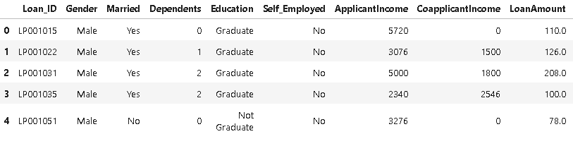
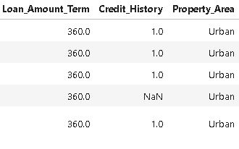
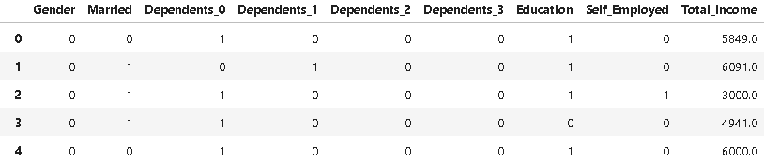
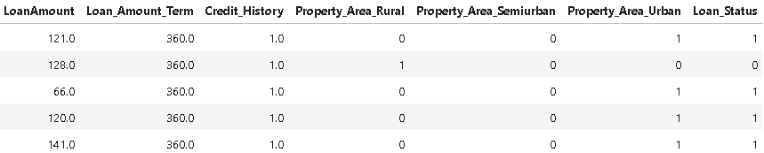
Original Column Layout
Revised Column Layout

Slide 6
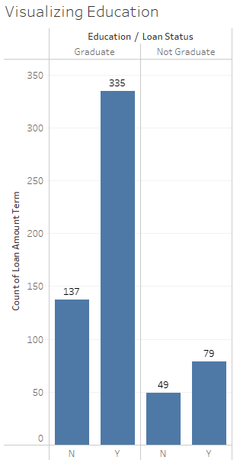
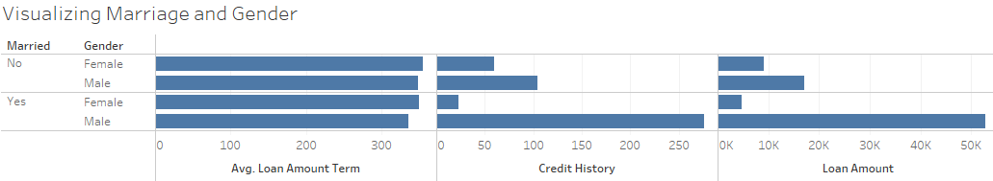
Data Comparisons Marriage and Gender
Education vs Loan Term

Slide 7
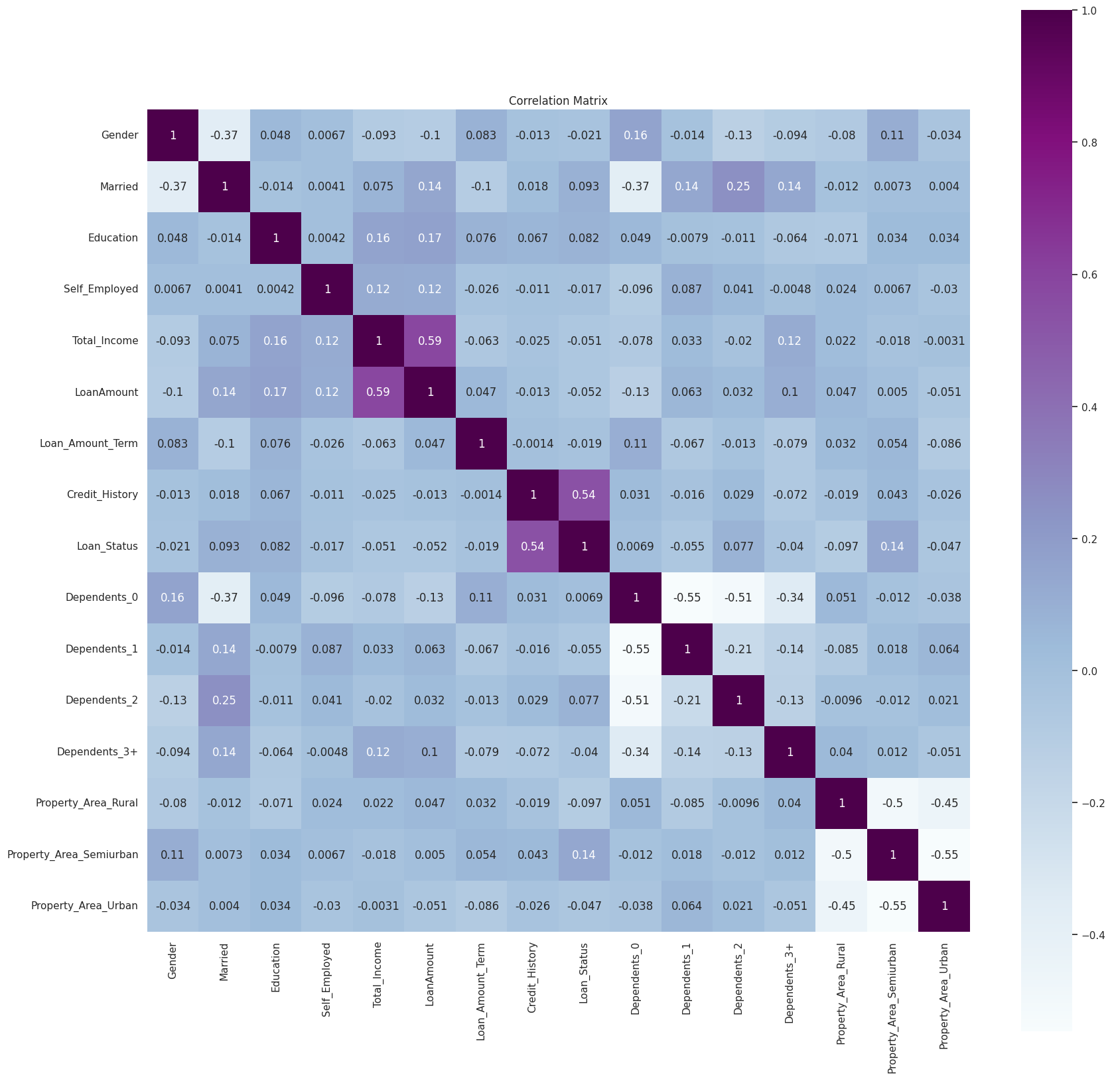
Correlation of different features

Slide 8
Machine Learning Models
Decision Tree
Neural Network
Logistic Regression
Random Forest Classifier
Pycaret & Scikit

Slide 9
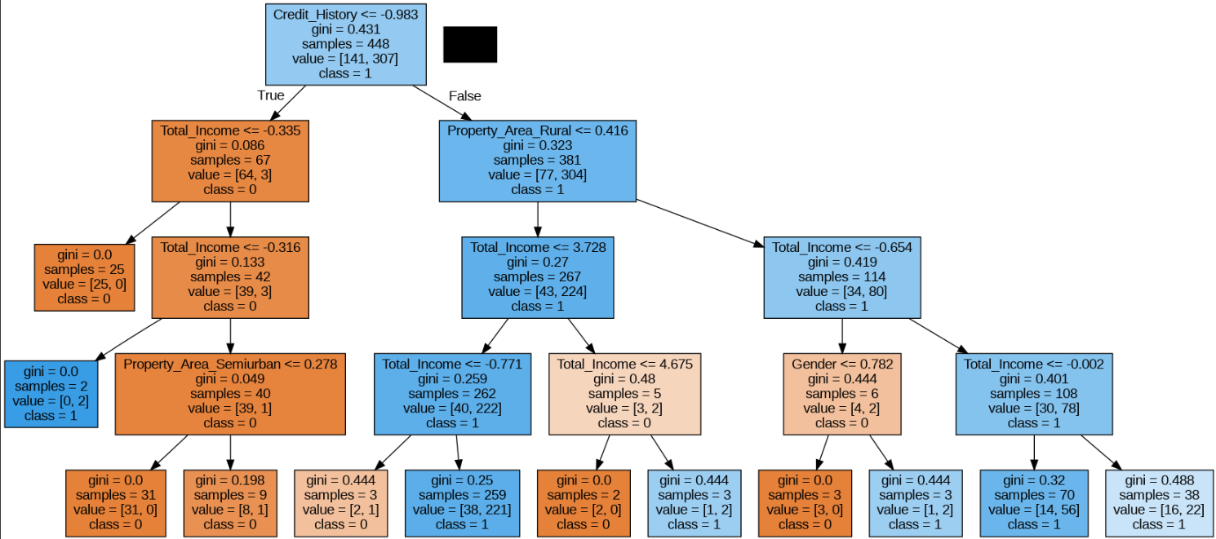
Decision Tree Model

Slide 10
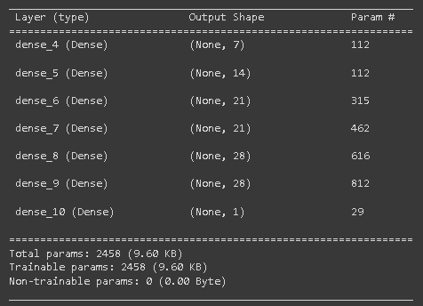
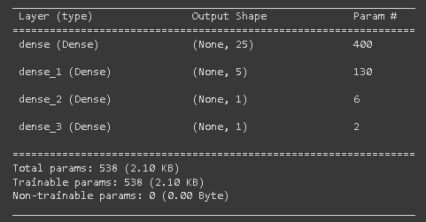
Neural Network Models
3 Layers – 78% Accuracy
6 Layers – 68% Accuracy

Slide 11
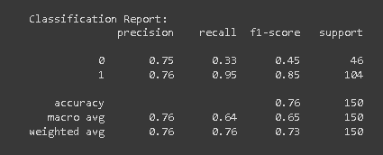
Logistic Regression Model

Slide 12
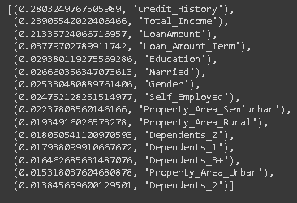
Random Forest Model
12

Slide 13
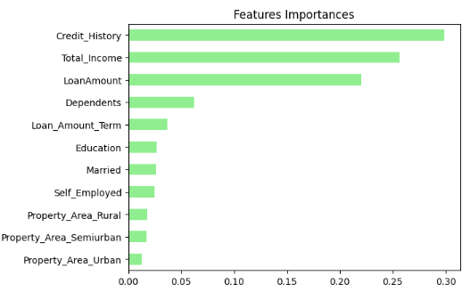
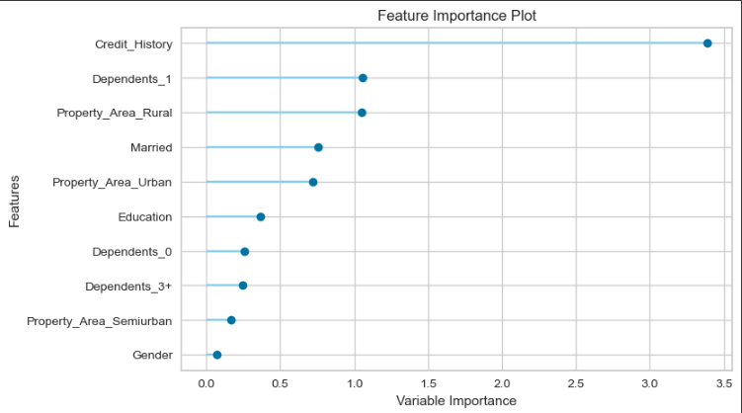
Feature Importances

Slide 14
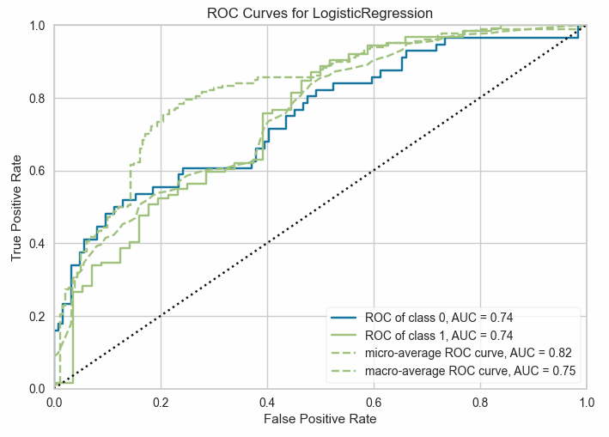
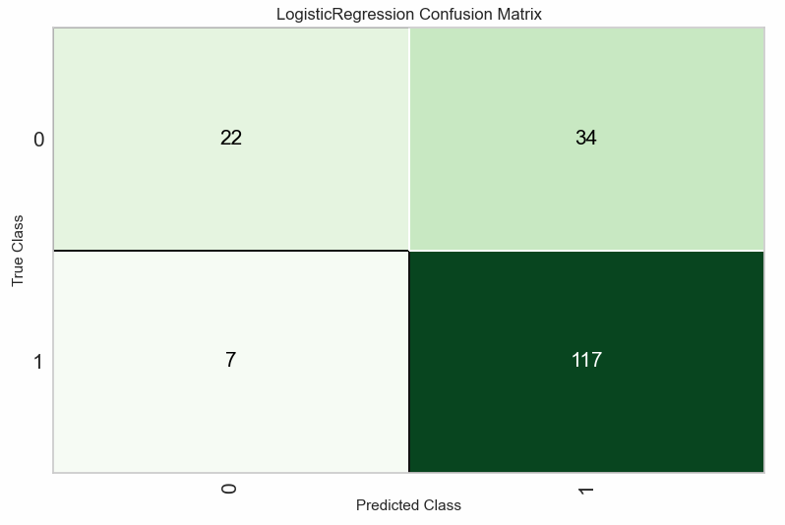
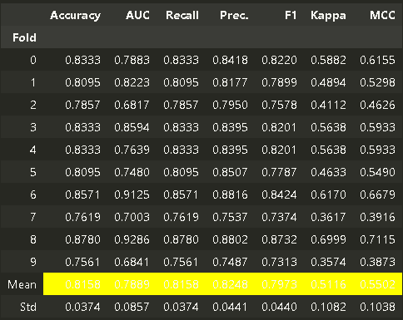
Pycaret
ROC Curves – Logistic Regression
Confusion matrix – logistic regression

Slide 15
Predictions
74%
Decision Tree Accuracy
76%
Logistic Regression Accuracy
78%
Neural Network Accuracy
79%
Random Forest Accuracy

Slide 16

Summary
By running different machine learning models, we have come to find out that our data and these models can predict anywhere from 74 – 79% accuracy if an applicant will be approved for their requested loan.

Slide 17


Thank You

